Slide 1
Capstone PROject gtp 1&2
JAVA
UI
</>
By: The Hustlers
Supervised by: Mr Ihsan Mahmood
UX

Slide 2
THE HUSTLERS
Kok Reena
Secretary, Presenter 2
Ho Kar Yan
Researcher
Najihah Binti Mohd Shahrudin Researcher
Cleo Isabelle Sim Wei Wen
Compiler, Researcher
Loke Kah June Researcher
Yeo Gi Deon
Leader, Presenter 1
Wong Jun Kai
PowerPoint editor, Assistant Leader

Slide 3
AGenda
Number | COntent | Page number
1. | Objective GTP1………………………………………………………….........
2. | Q1……………………………………………………………………………………….
3. | Q2……………………………………………………………………………………….
4. | Q3……………………………………………………………………………………….
5. | Q4……………………………………………………………………………………….
6. | Suggestions …………………………………………………………………....
7. | GTP2 Objectives……………………………………………………………….
8. | Features…………………………………………………………………………..
9. | Others……………………………………………………………………………….

Slide 4
Objectives – gtp 1
Identify StashAway’s product promise & product offering
Identify StashAway’s product/service Benefits
Recommend solutions to improve StashAway
Identify StashAway’s key Feature
Investigate whether StashAway fulfilled their product promise
Identify StashAway’s augmented products
Investigate StashAway’s brand representation

Slide 5
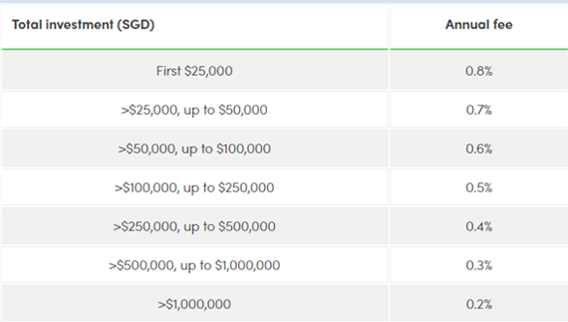
Key benefits to customers
Convenience to users
Do not need to invest themselves.
Use data to analyze and invest.
Allow multiple investment portfolios for 1 account.
Will instantly start investing.
Deposit and withdraw cash easily.
Simple and Easy To Choose Portfolios.
User Friendly.
Fast and Simple Money Transfer
Bank Transfer Consumed More Time.
Risk Management
Adjust Preferred Risk Level.
Merging of bonds, equities, commodities or cash.
Allow users to adjust risk level.
Automatically buy, sell , and rebalance.
Customizable Risk Level.
99% will not lose more than 6.5% of investment.
Investment will perform well in a pandemic.
Affordable
No minimum investment
Invest RM1 can gain benefits as those invest RM10,000.
Annual fee is between 0.2% to 0.8%
Expense Ratio is 0.165%
Invest with small capital.
No extra benefits when investing more in one account.
Charge not more than 0.165%.
Annual fee lower than competitors.
Some users charged for high management fees.

Slide 6
Key benefits to customers
Low Risk, High Return
Low Risk and High Return.
Earn Projected Return 2.4% per year.
No extra charges on fees.
No lock in period.
Deposit will be invested with extraordinarily low risk.
Withdraw money anytime for free.
Earn 2.4% Projected Return.
No Management Fees.
Deposit without Minimum Balance.
Upskill Users
Learn investment with StashAway Academy.
Ensure users with confidence with their investment.
Free Courses for Investing.
Basic, Intermediate, and Advance Courses.
Access courses anytime
Updated news on Financial World.
Listen to Product Podcast.
Lack of Video or Courses.
Earn Side Income
Invest according to goals.
Create Portfolio based on Investment Intention.
Invest for retirement, income, and life goals.
Adjustable Risk Level.
Multiple Portfolio with different goals in 1 account.
Return will be targeting towards their goals.
Earn extra savings.

Slide 7
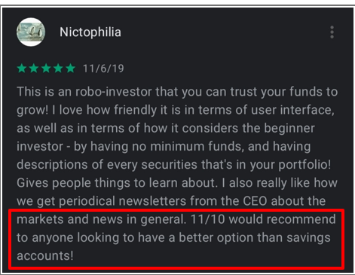
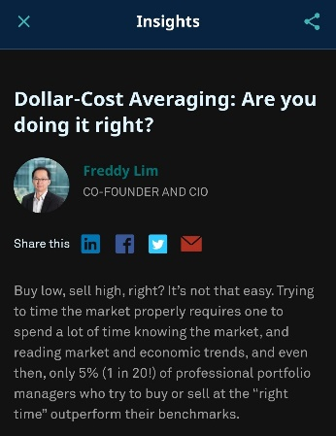
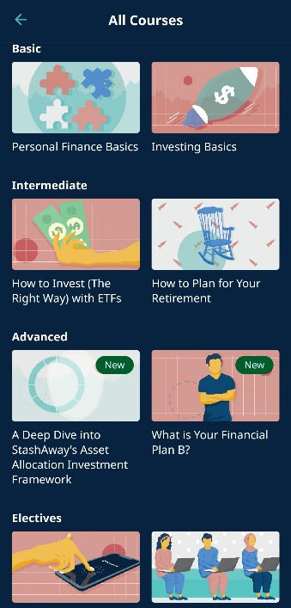
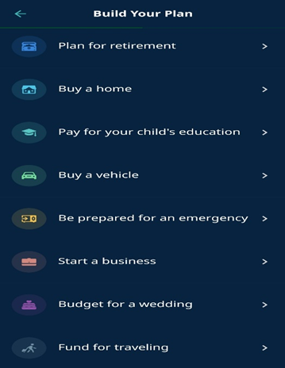
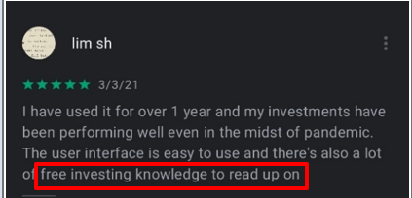
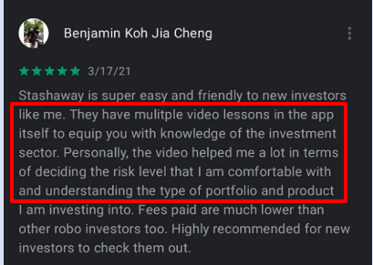
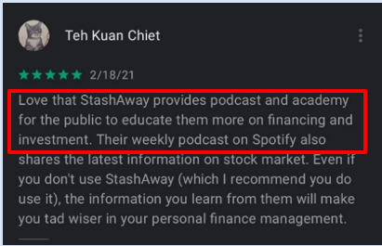
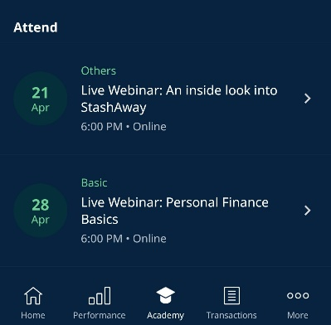
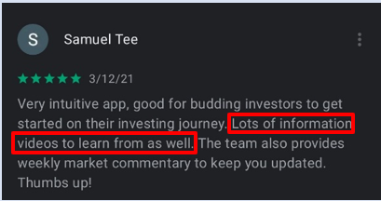
Key Features to customers
Academy
Personal Finance and Investing Courses Provided.
Financial Education at anytime.
Basic, Intermediate, Advanced, and Electives Courses.
Live Webinar for investors.
StashAway’s Insight.
Multiple Video Lesson Available.
Gain Knowledge to start their investment.
Provide Latest Information.
Investment plan
Create Own Investment Plan or Portfolios.
Retirement, Home, Vehicle, Business Plans.
Invest on any amount.
Increase or Decrease amount any time.
Clearly Stated Investment Portfolios.
Gain Understanding on Types of Portfolios.
Use Limited Cash Flow to Invest.
Cash Management
No Minimum Balance.
Earn Competitive Returns.
Earn Projected Return of 2.4%.
No Deposit Requirement.
Earn Competitive Rates or move to investment
No Management, Setup, Exit Fee.
Unlimited Transfers in and out
Better than Putting Money in Savings Account.
Earn Full Rates on Any Balance.
Takes 2 to 3 Days to Deposits.

Slide 8
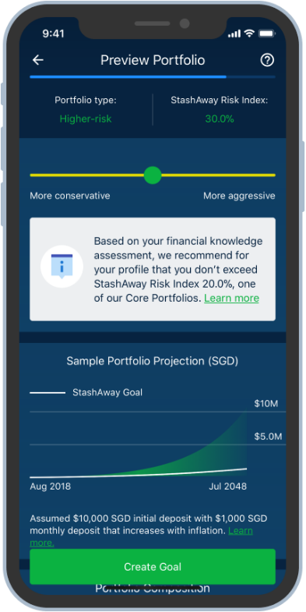
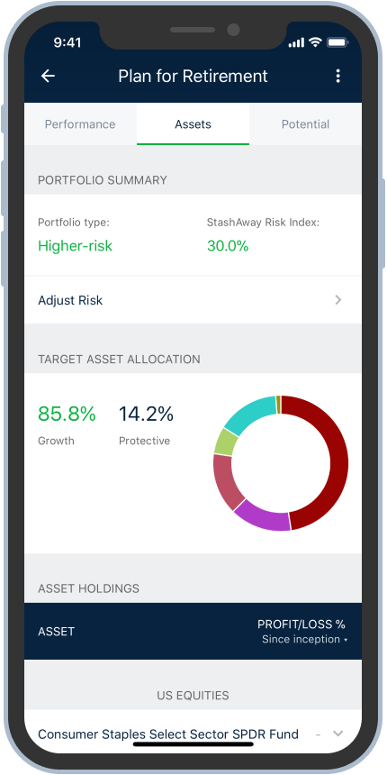
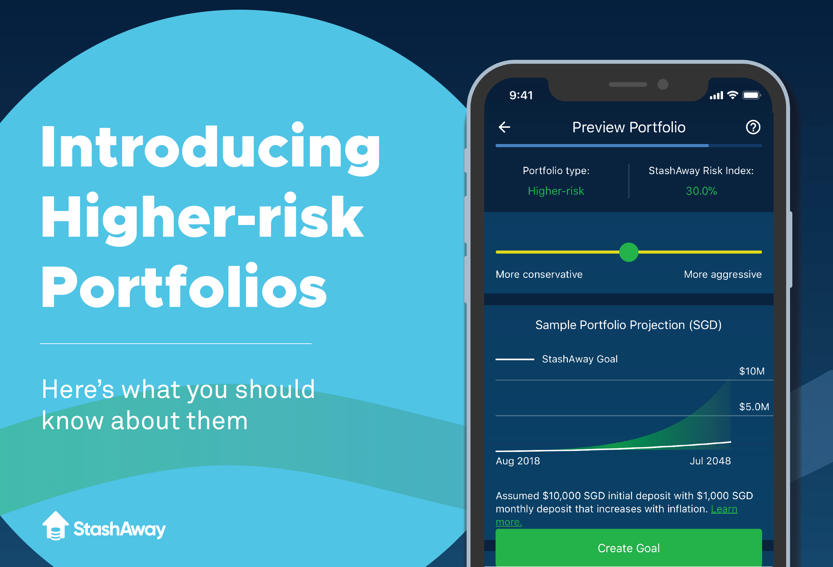
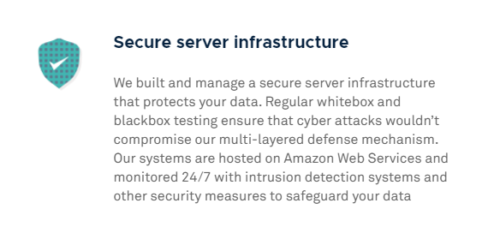
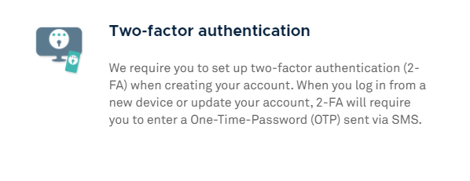
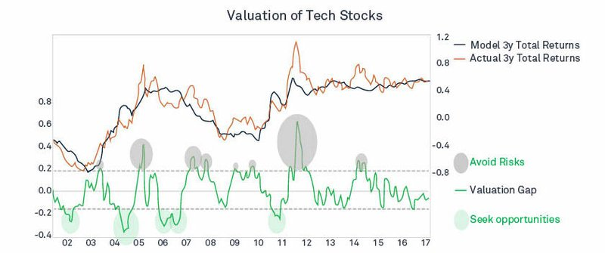
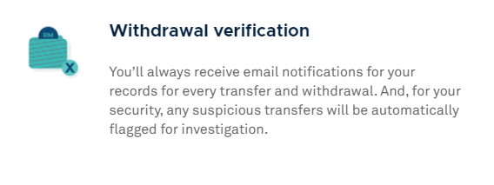
Key Features to customers
ERAA
Economic Regime-Based Asset Allocation.
Managing Risk and Maximizing Returns.
Risk Shield.
Stop Investing in Overvalued Assets.
Maximize Customers’ Long-Term Returns.
For Customers That Have No Free Time.
Stop Investing to Minimize Risks.
Security
Licensed By Securities Commission Malaysia.
Capital Market Services Licenses.
Secure Server Infrastructure to protect data.
Two-Factor Authentication.
Withdrawal Verification.
Unauthorized Transfer will be automatically stopped.
Good For Customer With Insecurity.
Invest Without Any Concerns.
Account Will Not Get Hacked or Stolen.
Every Transfer Records Will Be Sent to The User’s Email
Risk Index
Prevent New Users From Losing Money.
Give Users a Confirmation Before Investing.
Give Confidence When Investing.
Users Wouldn’t Lose More Than Given Percentage of Assets.
Portfolio is qualified by StashAway Risk Index.
Measure Risk When Investing.
Value-at-Risk-Metric.
Measure Potential Loss in a Year.
99% of Not Losing More Than Given Percentage of Assets

Slide 9
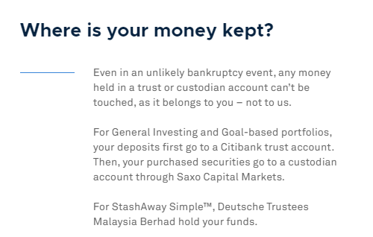
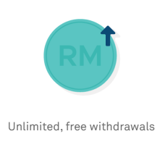
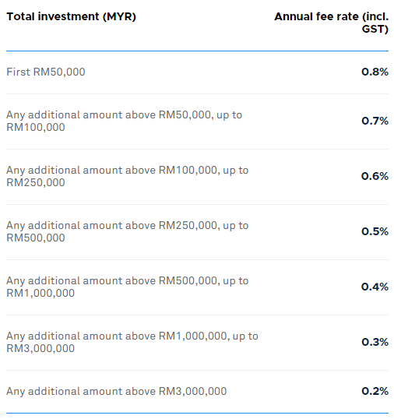
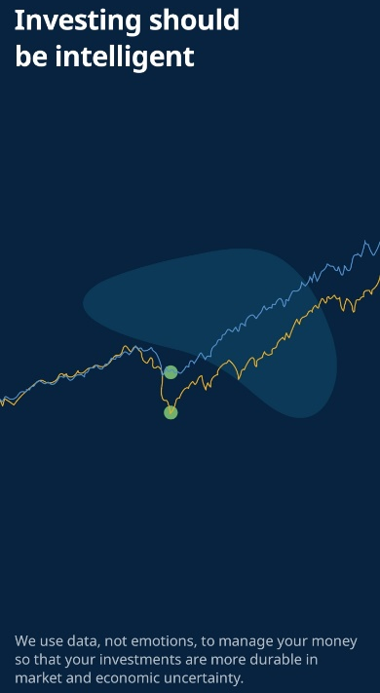
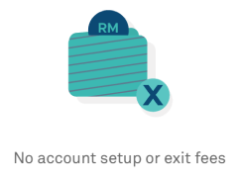
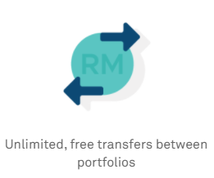
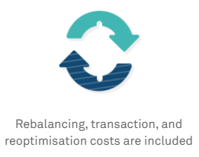
Investigate Stashaway’s brand representation
1. Innovation
enables wealth management through seamless digital experience, driven by algorithm & data
intelligent investing
2. Cost Efficiency
brands itself as a platform for personal and low cost investing
cost efficient trading
ensuring competitive and minimal fees
3. Transparent & Secure
No hidden fees
Secure systems supported by Amazon Web Services for data privary & regulation
Customer funds seperated from company
4. Flexibility
low barrier to entry ( no account opening fees, no minimum investment amount)
low barriers to exit ( withdraw anytime without charges and close their accounts)
lenient policies that alleviate burden

Slide 10
Investigate Stashaway’s brand representation
5. Customer- Centric
4 types of customer service: email, telephone, messenger & whataspp
Easily find icon to contact customer services
Respond immediately to assist and resolve
6. Accessibility
Platforms are user-friendly
Accessible through multiple platform
4.5+ star rated Easy to navigate and use
8. Reliability
Consistently good quality & performance, very reliable & can be trusted
Offers high-quality financial advice & products
Users receive up-to-date information frequently
7. Value Driven
StashAway team has contributed & accumulated value to industry
regularly hosting talks and interviews, maintaining positive relationships
goal to achieve long term accomplishment, involving training and certification of front-line personel

Slide 11
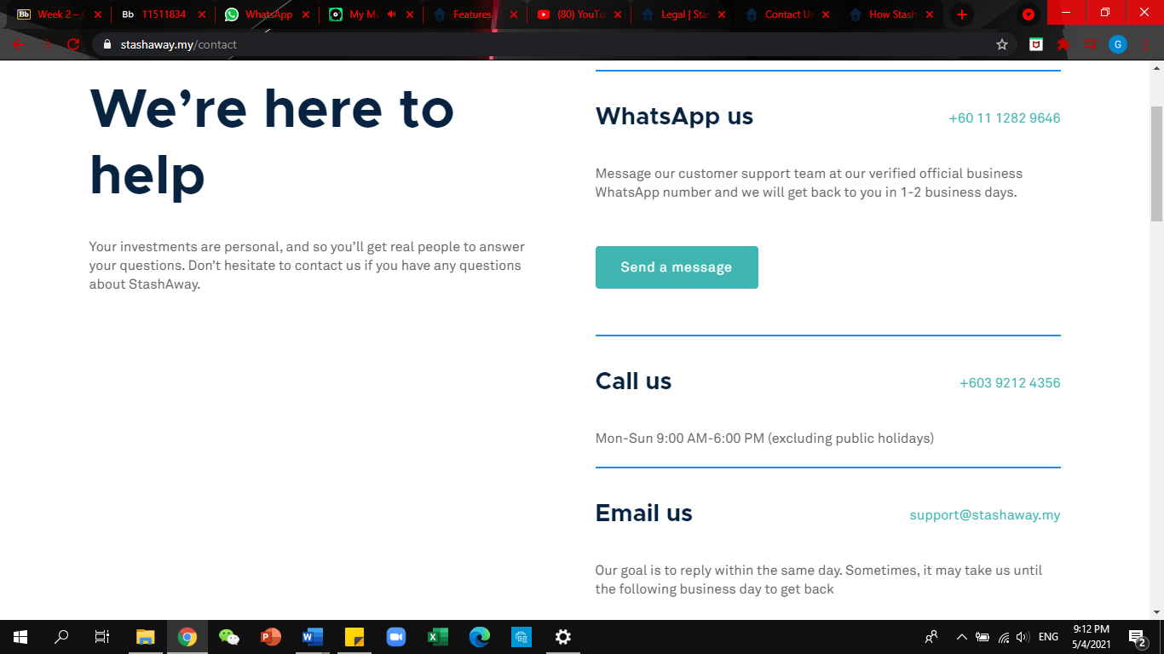
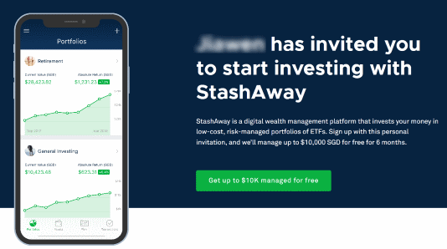
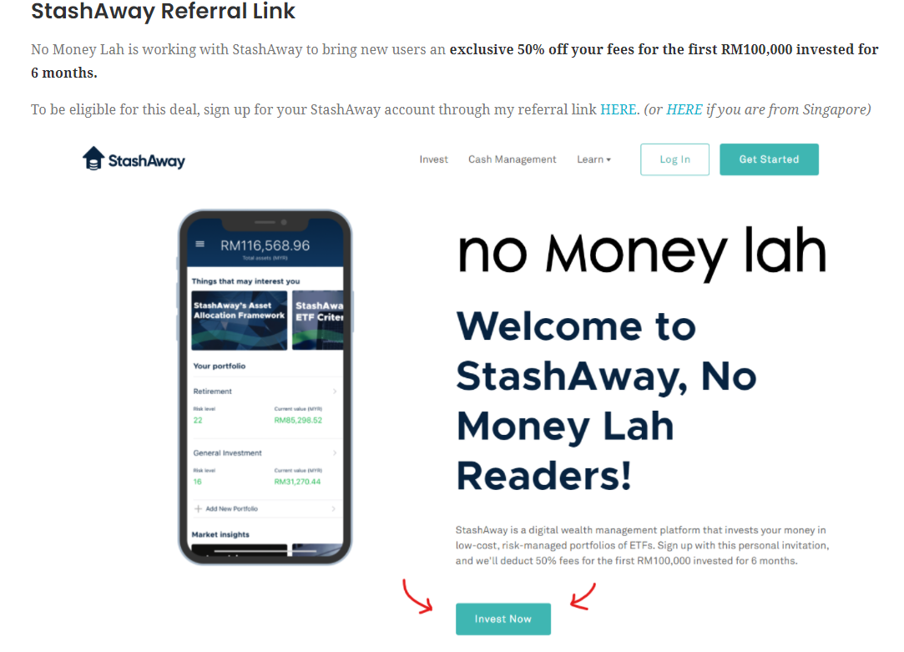
Identify Stashaway’s augmented products
1. Referral Program
New customers able to use referral link
No limit to refer
Partnered with “No Money Lah”
3. Software Update: Mobile App
App will update accordingly to improve the experience of users.
Fix bugs that was faced by most of the users.
2. Customer Support Team
Users can contact customer service Website allows Whatsapp, call and email
App allows Whatsapp
Why is it AE:
not a feature
Encourage customers to invite their friends or families
add value to the customers when they successfully refer
Why is it AE:
Ensure customers have a good experience
Customers will need help while facing technical issues
Why is it AE:
Enhance users’ experience
App will only be updated when there is customer feedback or bugs

Slide 12
Identify Stashaway’s augmented products
5. Money- weighted Return
another way to calculate users’ return
calculates growth rate of funds invested over evaluation period.
6. Discount/ Promotion
provide discounts for users that are signing up
collaborated with Guidesify
4. Time-weighted Return
way to calculate users’ return
Easier to make comparison between portfolios
Calculates rate of return over given period for one unit of cash.
Why is it AE:
Enhance users’ experience
Allow users to have more detailed information
Report based on gross return
Why is it AE:
enhances customer experience
Does not affect the performance of portfolio.
Users can still review their returns
Why is it AE:
used to promote brand awareness and traffic
additional element to improve customer experience

Slide 13
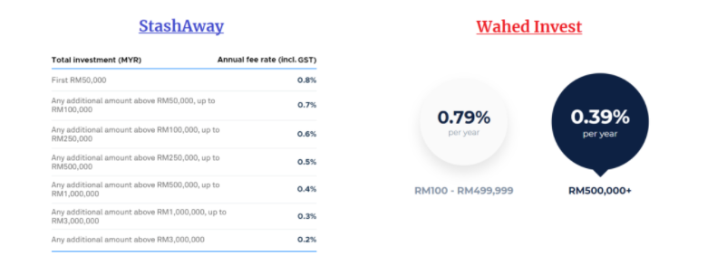
Recommendation
1.
2.
3.
User Interface
Management Fees
Software Updates
Hidden Conversion Rate of MYR to USD
Barely any visibility on conversion rate
Portfolio return varies drastically
Wahed Invest Fees Lower (0.01%) on minimum deposit
Invest < 100,000 < fees < Wahed
Invest > 100,000 fees > Wahed
makes bio metric slow, hangs, or unresponsive
phone have to restart
Solution
Solution
Solution
Add Proper Conversion Rate in the User Interface
Add Extra Tabs To Show Conversion Rate
Notification To Show change In Portfolio
Test It Before Launching Updates.
Allow Beta Tester To Test The Update First.
Decrease Management Fees
Lower the Percentage of the 7 Tiers of Fees

Slide 14
Recommendation
4.
5 .
User Experience
Customer Service
Users Struggle to Deposit Funds
Struggle to Manual One Time Deposit.
Can’t Register Account With More Than 1 Loan
Long Time To Respond
Delays When Comes To Documents and Approval.
Solution
Solution
Analyze problem through user’s Point Of View
Alter Software
Communicate with Bank and Solve The Situation
Increase the Rules to Maximum 4 Bank Loan.
Hire More Staff to Handle Customer Service.
Train Staff to Figure Related Problems.

Slide 15
Objectives - GTP 2
List different category of Features of competitors
Identify the key features of competitors
Compare StashAway app with competitors
Investigate Stashaway’s brand represnetation
Present findings to StashAway in terms of strength and weaknesses
Suggest improvement on StashAway feature

Slide 16
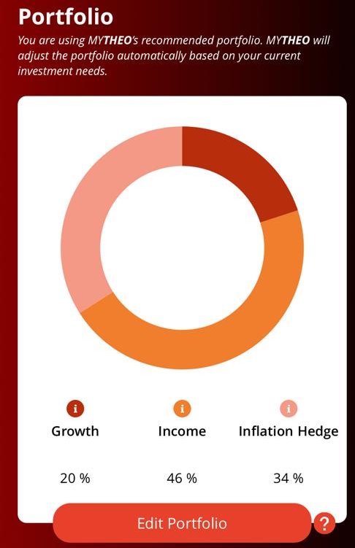
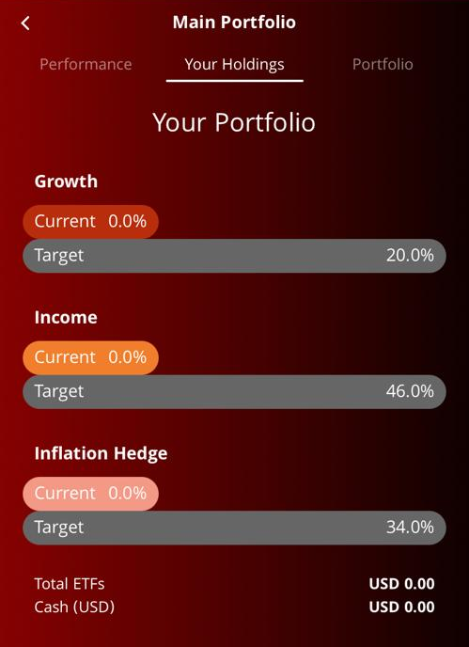
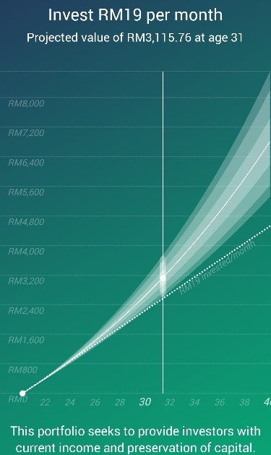
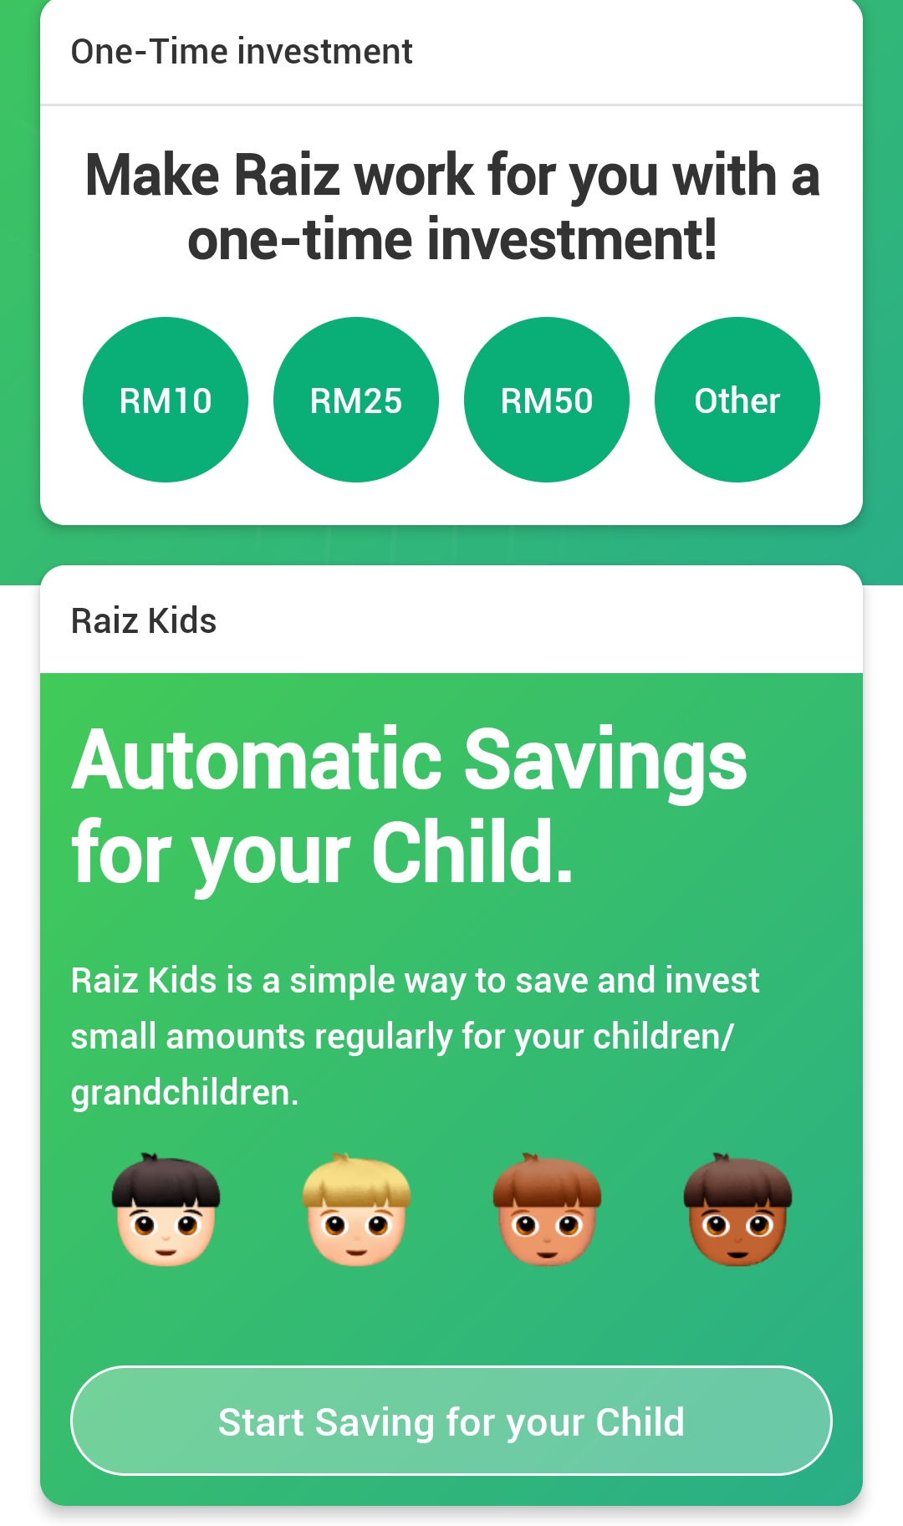
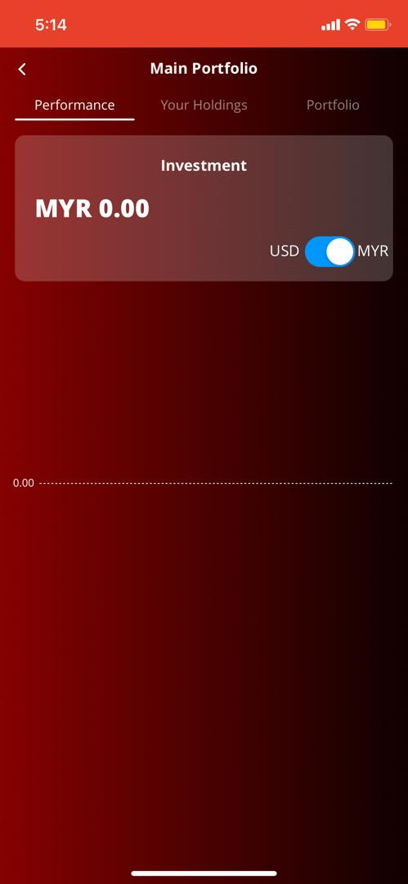
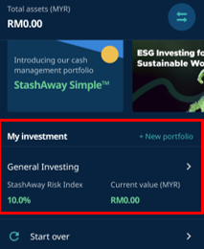
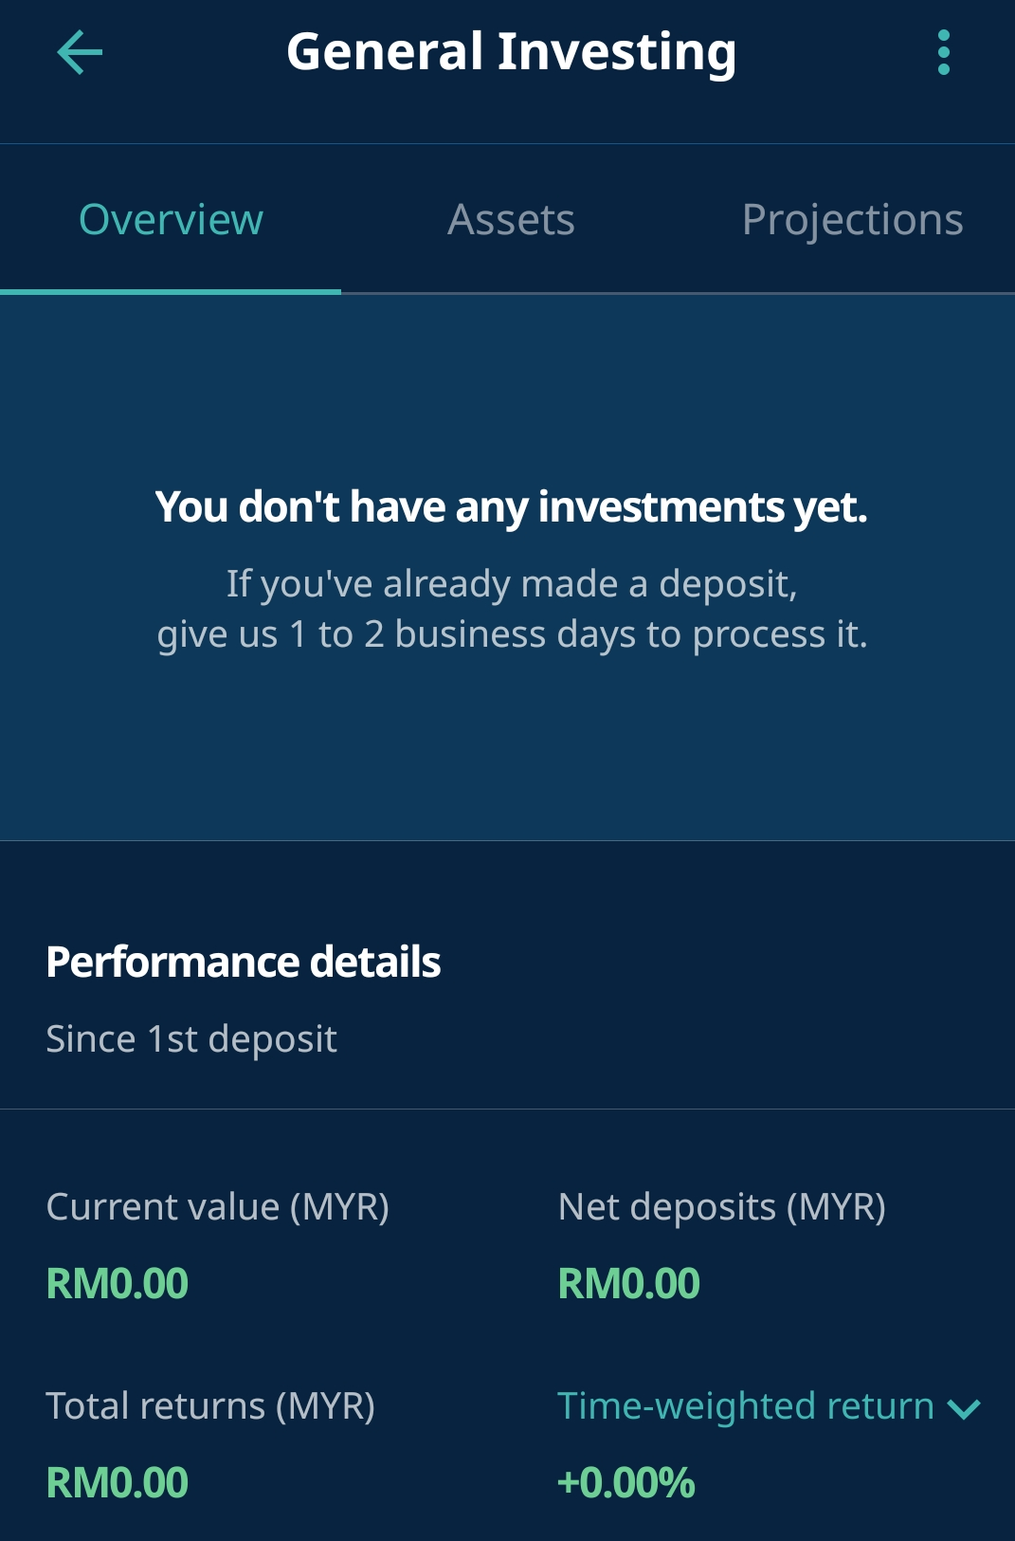
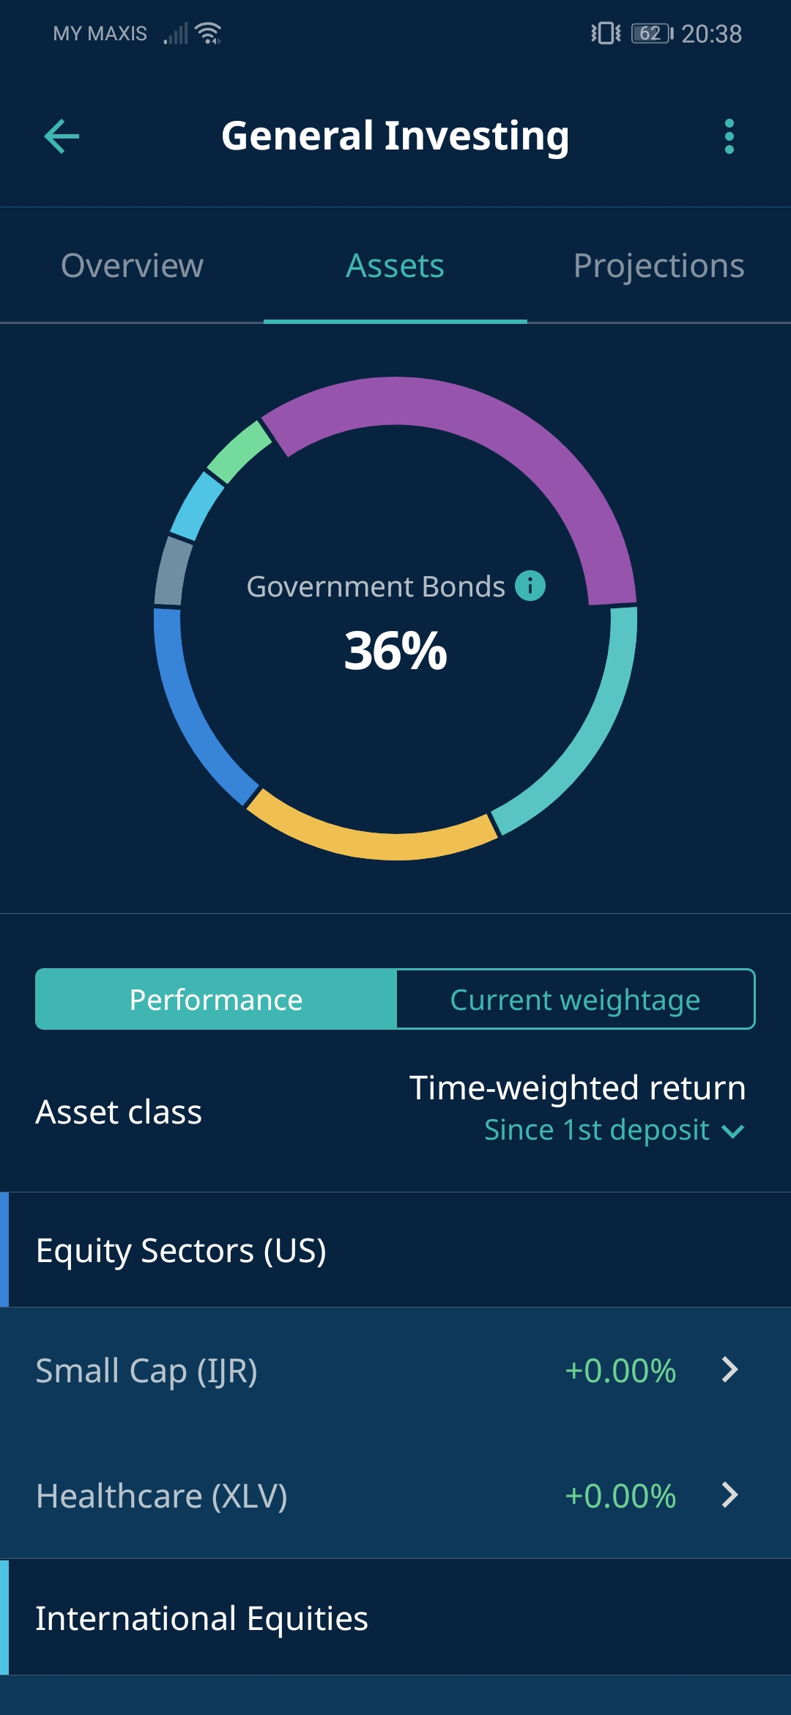
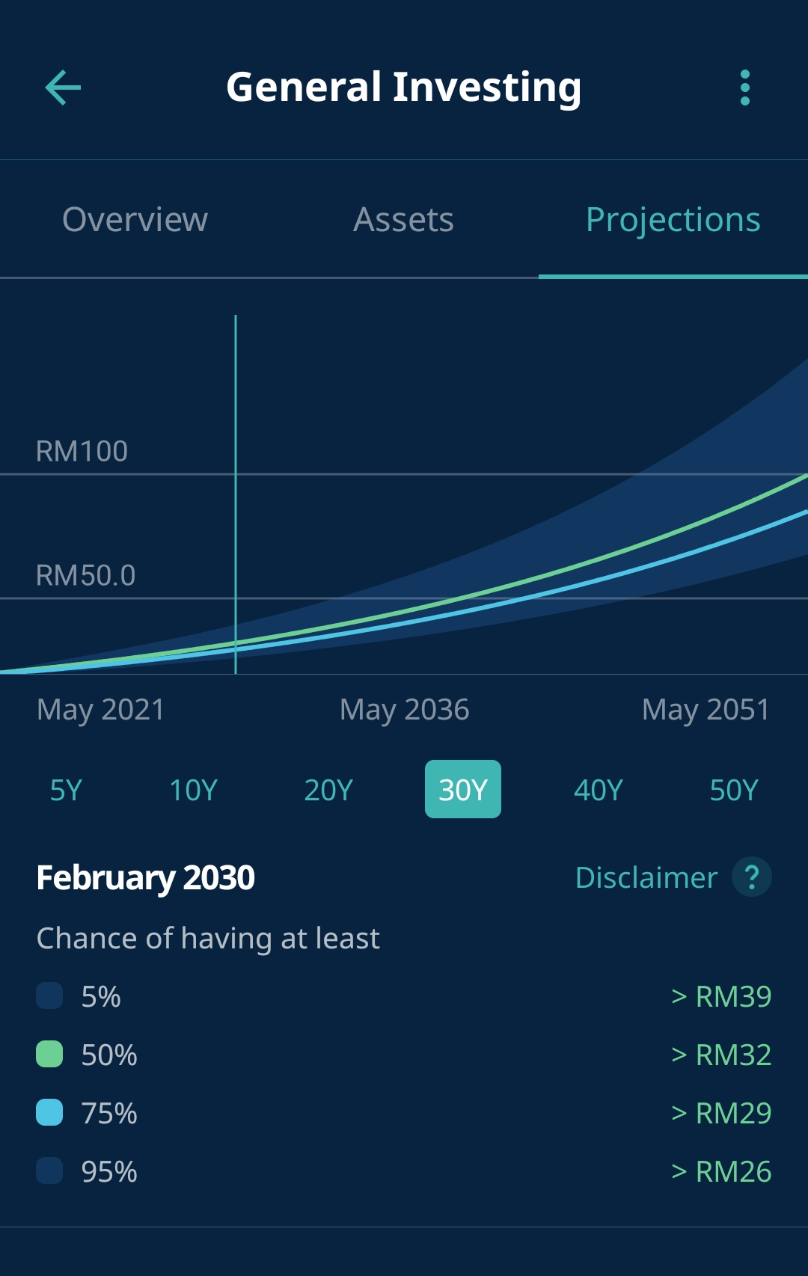
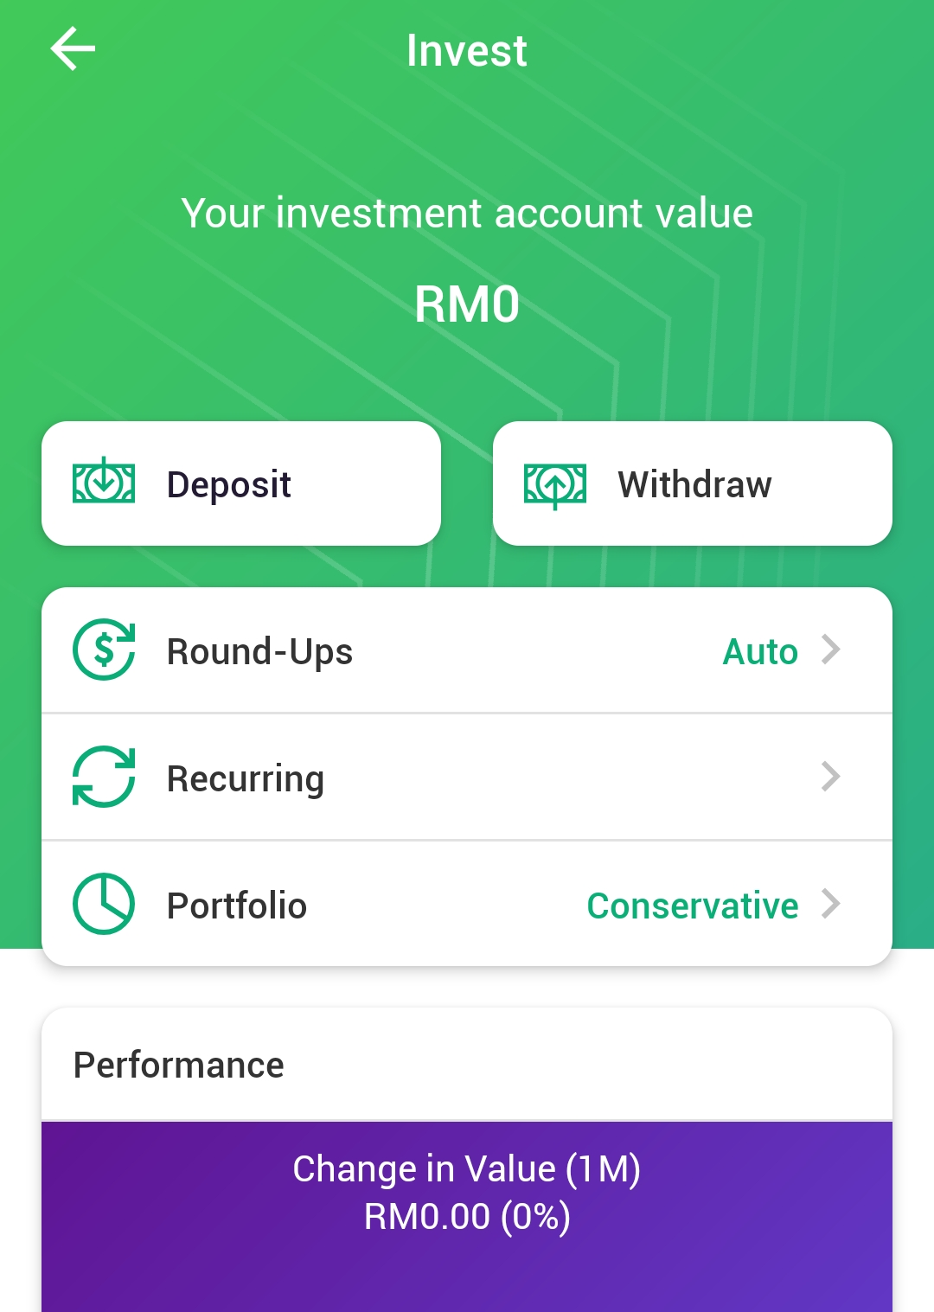
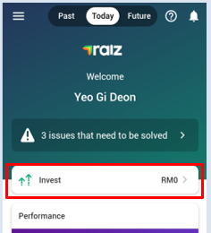
01.
Home
My Investment
By: Yeo Gi Deon
Comment
User- Friendly – Navigation is Complicated
Not Comprehensive – Projections and limited performance details.
Ease to Understand – Explanation for most of Their Tools.
Comment
User- Friendly – Navigation is Simple, Can be Good or Bad
Not Comprehensive – Limited Performance Details with no Projections and Allocations.
Difficult to Understand – Limited Explanation for Their Tools.
Comment
User- Friendly – Navigation is smooth
Comprehensive – Evaluation, Allocation, Projections.
Ease to Understand – Explanation for most of Their Investment Tools.
Competitor 2 – My-Theo
Content of Investment Tools
Evaluate investment with Overview Assets, and Projections.
Details includes Return Current Value, and Deposit.
Assets Indicate Allocation of Investment.
Project Express Possible Return From 5 to 50 years.
No investment for Kids
Content of Investment Tools
View Overall Progress of the Investment.
Account Value, Performance Details, Deposit or Withdraw Cash.
No features shows Allocation of Investment.
Projections that shows Possible Future Returns.
Raiz Kids- Allow Users to Invest and Save for their Children.
Competitor 1- Raiz
Content of Investment Tools
Check Investment Details at the Main Portfolio
View User’s Performance, but Limited Information.
No allocation of Investment
No Projection of Investment
No Investment for Kids.
StashAway

Slide 17
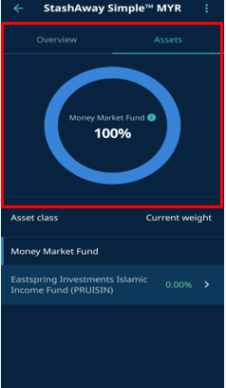
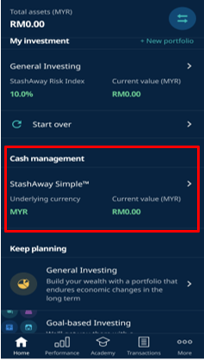
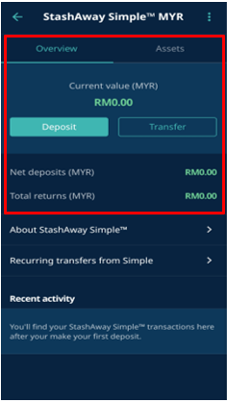
01.
Home
Cash management
StashAway Simple
By: Yeo Gi Deon
Comment
Straightforward – Easy to understand on how the feature.
Easy to access – Every tool regarding cash management is accessible in this place.
Informative – Helpful information that let users understand more about the investment.
Comment
✖
Comment
✖
Competitor 2 – My-Theo
Cash management tools:
StashAway Simple
View Current Value, total Deposit, and Total Return.
Learn Cash Management and set a Recurring Transfer
Shows where deposit has allocated to.
Competitor 1- Raiz
Cash management tools
Does not have this feature ✖
Cash management tools
Does not have this feature✖
StashAway

Slide 18
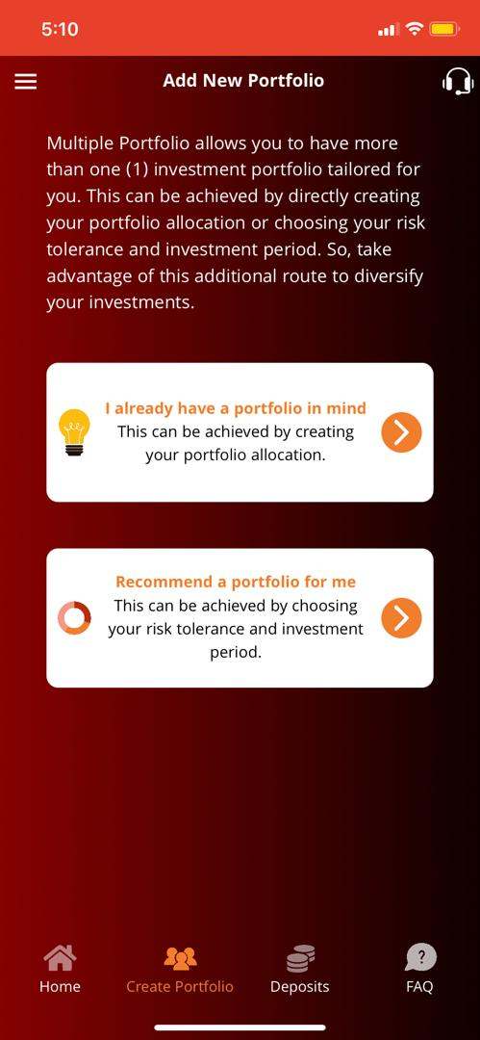
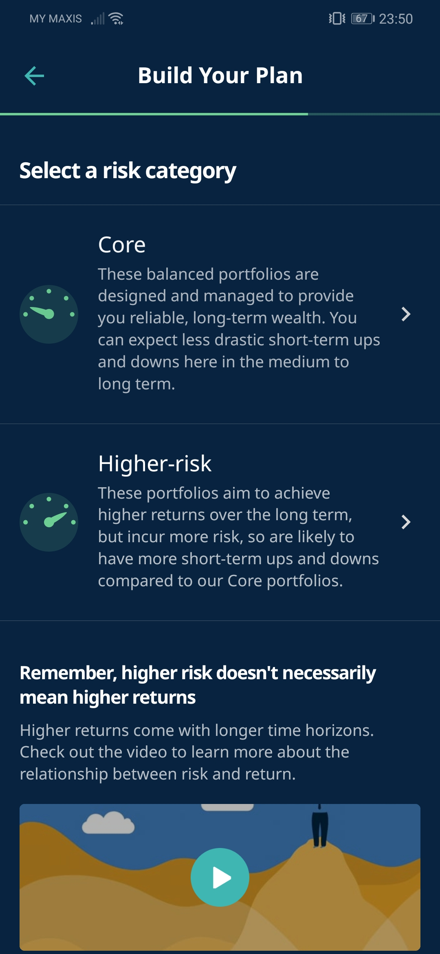
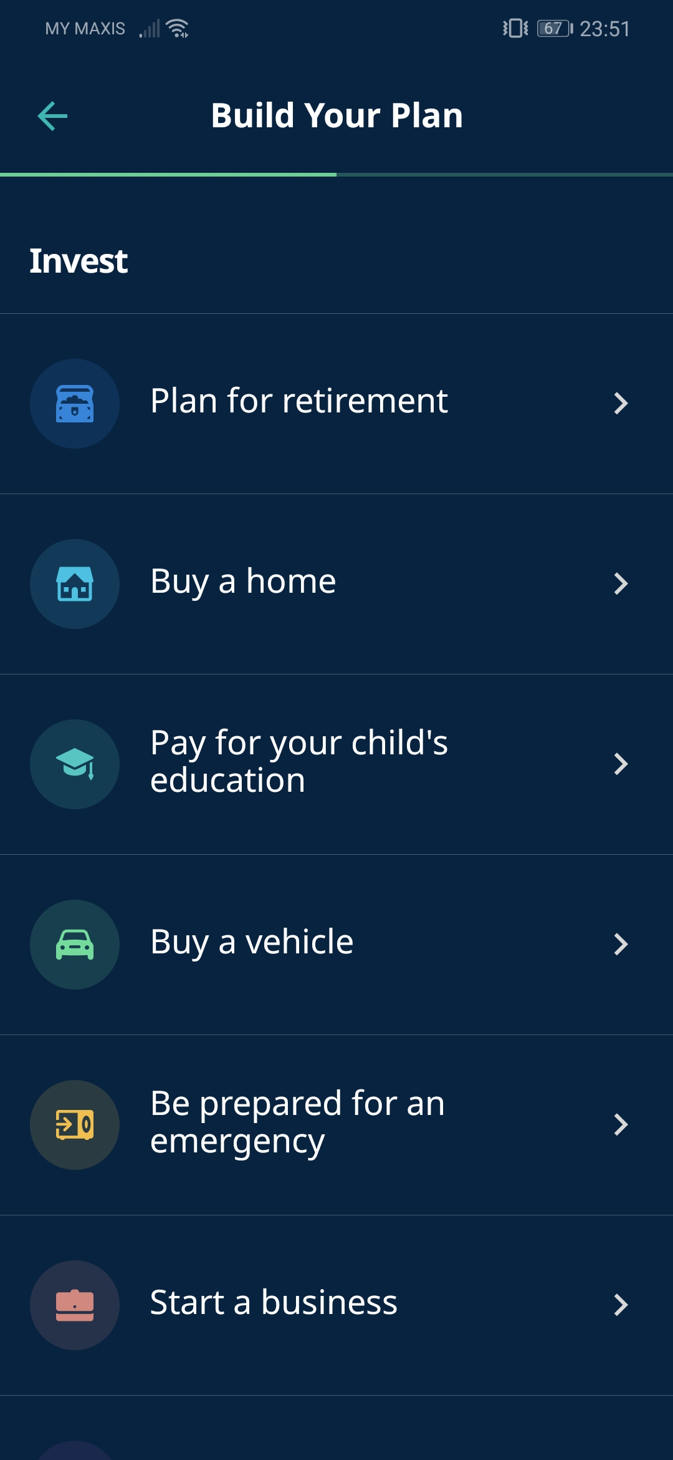
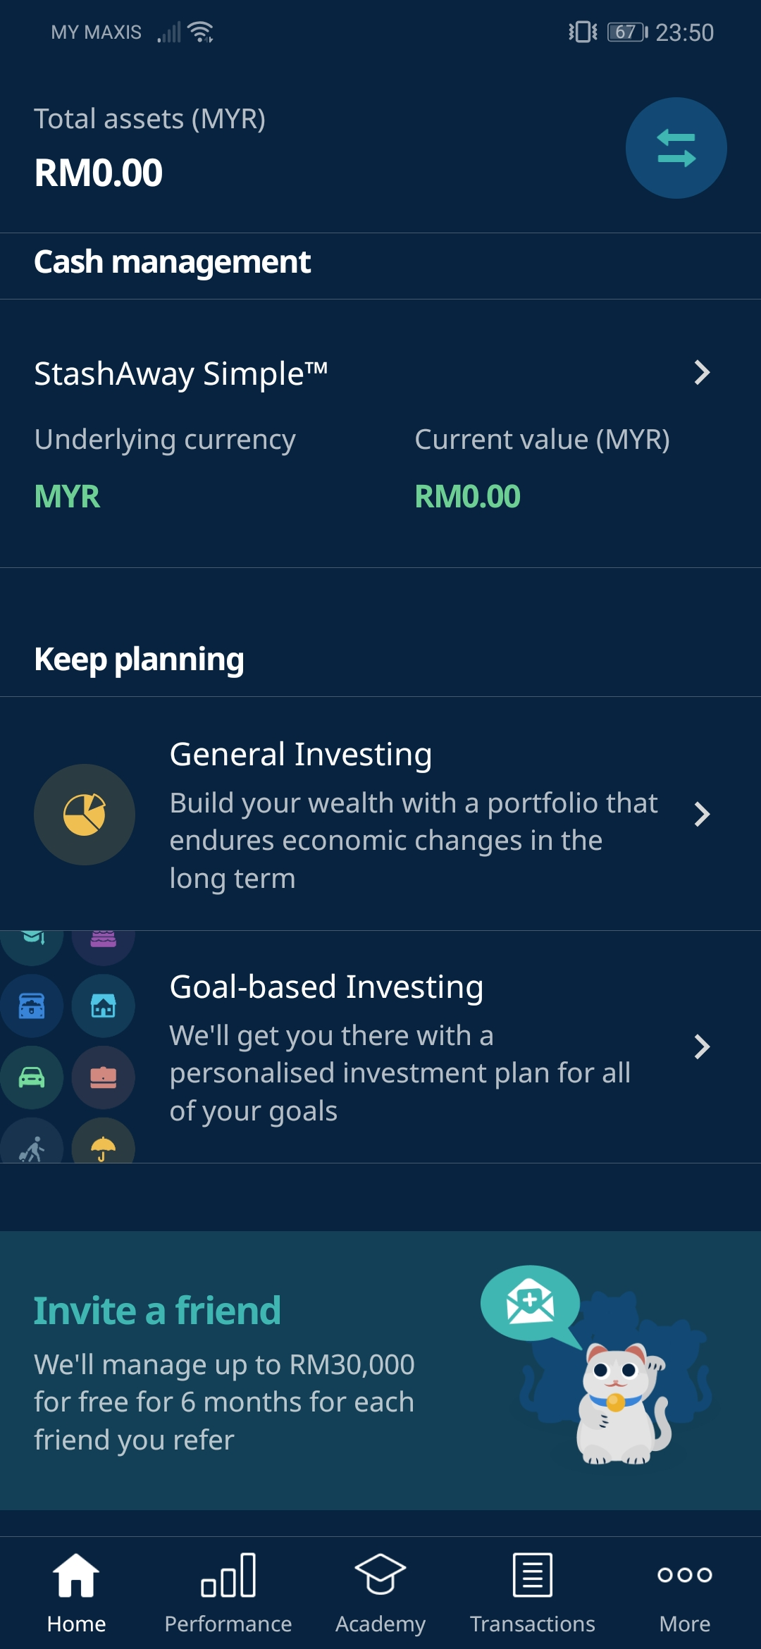
01.
Home
Keep planning
By: Yeo Gi Deon
Comment
Not goal-oriented – Users can’t create portfolio with their set goals.
Poor UI design – Unattractive to see, hierarchy order of the design is unusual (option to choose the portfolio should be shown first, not the wording).
Freedom to customize – Allow users to have portfolios according to their preferred allocation of the investment.
Comment
Goal oriented – Users are able to set their portfolio according to their goals.
Good UI design – Clear and attractive to see, hierarchy order of the design allows users to focus on the point.
Lack of customization –Only allow users to create portfolios that they provide.
Comment
✖
Competitor 2 – My-Theo
Portfolio Tools
Create More Than One Portfolio.
No option for Goal-Based Investing Portfolio.
Recommended portfolio for users to choose risk tolerance.
Create Portfolio based on their preferred allocation.
Competitor 1- Raiz
Portfolio tools:
Allow More Than One Portfolio.
General Investing and Goal-Based Investing Portfolio.
Selectable Risk Category – Core or Higher Risk.
Selectable Risk Category According to User’s Goals for Goal-Based Investing.
Portfolio tools
Does not have this feature✖
StashAway

Slide 19
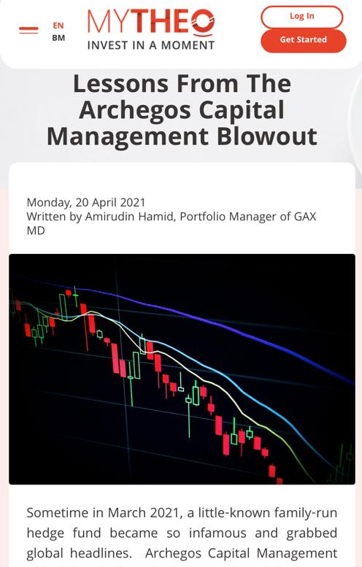
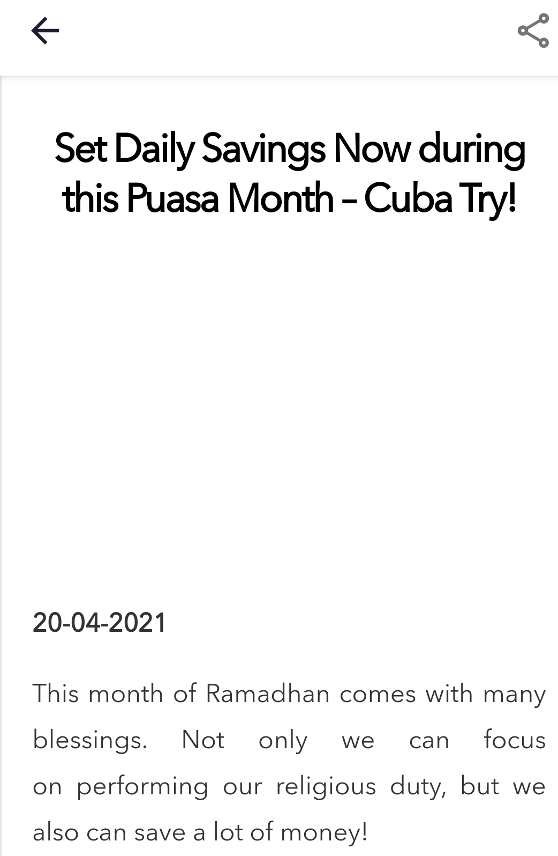
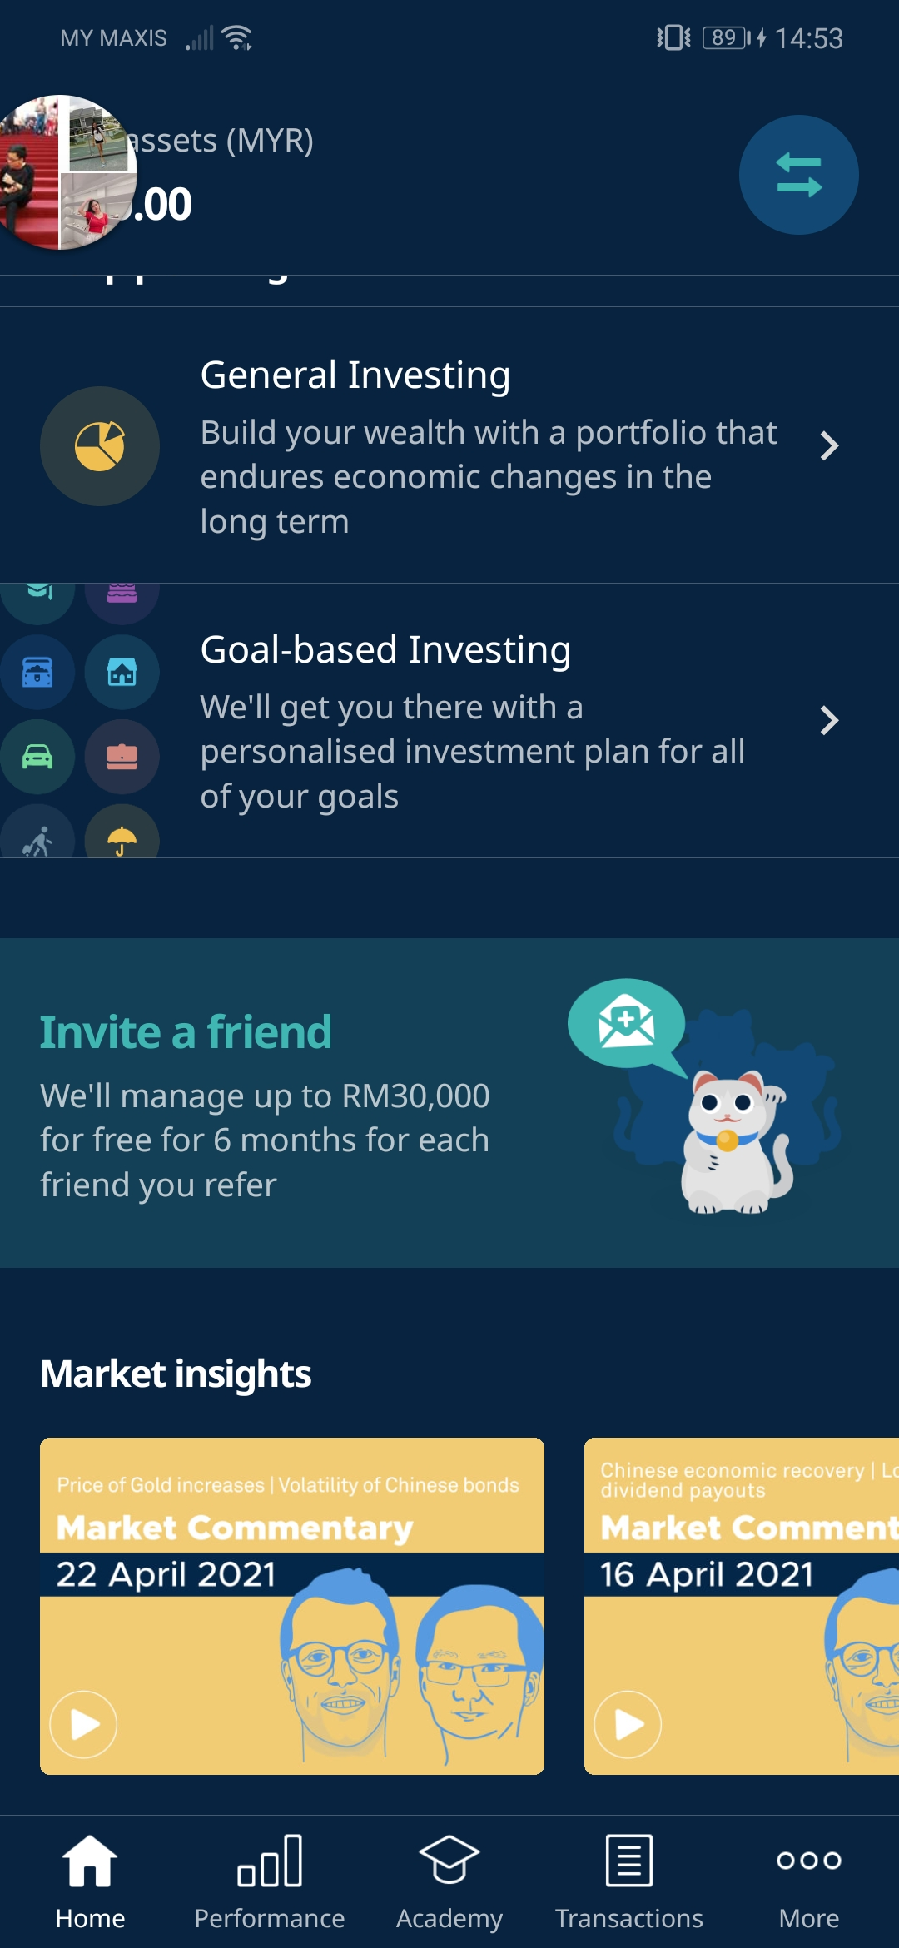
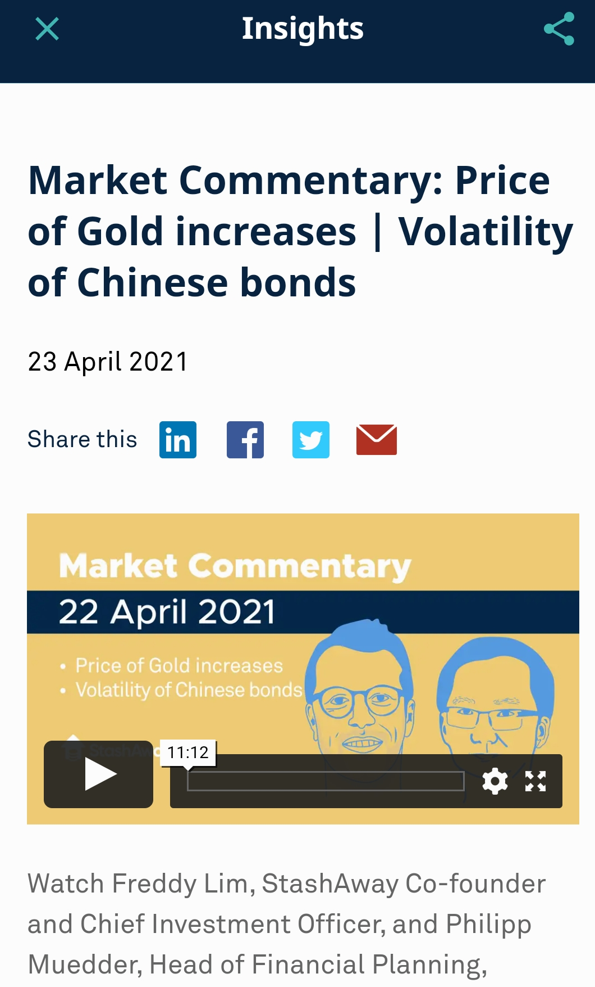
01.
Home
Market Insights
By: Yeo Gi Deon
Comment
Informative – Countless blog for users to see.
Not educative – Does not provide financial news and insights.
Confusing – Mixing both English and BM in the blog may cause users to be unable to understand it.
Comment
Lack of information – Limited articles for users to access.
Educative – User can learn about investment from insights and financial news.
Clear – Users can easily understand the insights with one language only.
Comment
Informative – Numerous news provided to the users to see.
Educative – Provide financial news and insights that help users to learn investment.
Clear – News in English only.
Competitor 2 – My-Theo
Content of Insight:
Provide Financial News that help user know about investment.
Provide Insights that discuss about the problem faced by the brand.
Has Performance Review of investment that update every month.
Only English is available.
Content of insights:
Updated Financial News
Insight that helps users to understand investment.
No performance review from Market Insight’s feature.
English only in Market Insights.
Competitor 1- Raiz
Content of insight
No Financial News, only provides latest update on Raiz app, investment tips and promotion.
No Insights from Raiz Blog.
No performance review for users for their investment.
Two Language: English and BM
StashAway

Slide 20
02.
Performance
Performance Details
By: Cleo isabelle sim wei wen
Competitor 2 – My-Theo
Competitor 1- Raiz
Overview of Performance Details
Found under “Today” Feature in Home Page.
No Currency Options available, only in MYR.
Exchange Rate and Security Prices are Not Stated.
Description of investment terminologies are not provided.
Overview of performance Details
Found under “Main Portfolio” feature panel.
Currency options- MYR and USD
Exchange Rate and Security Prices are not Stated.
Description of investment terminologies are not provided
Overview of Performance Details
Can be found under “Performance” Feature.
Currency Options - MYR and USD.
Latest date for Exchange Rate and Security Prices is Stated.
Comprehensive Descriptions of Investment Terminologies.
StashAway

Slide 21
03.
Academy
Academy
By: Ho Kar yan
Comment
Accessible – Users can receive information by using the mobile app.
Straightforward – Easy to use and navigate.
Flexible and convenient – Users can schedule their courses anytime and anywhere.
Comment
✖
Comment
✖
Competitor 2 – My-Theo
All courses:
Wide Range of Personal Finance and Investing Courses.
Take courses whenever the user goes.
Schedule their courses anytime.
Basic, Intermediate, Advanced, Electives Courses.
Competitor 1- Raiz
Live webinars:
Live Webinars for investors on making investment.
Up-To-Date Content that is relevant to investors.
All courses:
Does not have this feature ✖
Insight:
Lots of insights to browse
Can read article about company and investment.
All Courses
Does not have this feature✖
StashAway

Slide 22
04.
Transactions
transactions
By: Cleo isabelle sim wei wen
Comment
Ease of access – Easily find the feature from its icon.
Categorized- The transaction history can be viewed based on the user’s desired category.
Comments:
Ease of access – Can be found easily within one click.
Categorized – Pending and completed transactions are sorted clearly.
Comments:
Hard to access – Difficult to find as it is under other features.
Uncategorized – Transactions are not sorted based on the status; thus, it lacks clarity
Competitor 2 – My-Theo
Content of transactions
Can be found under “Transaction” Feature.
Show Status of each transaction.
Different Status are displayed together in a chronological manner.
Options to view transaction. (e.g., All Account Transactions, General Investing, StashAway Simple)
Total Amount of Deposits and Withdrawal are not shown.
Separate column for notice is not provided.
Content of Transactions
Found under “Activity” from the “Main Portfolio” feature.
Status of each transaction is not shown.
All deposit/withdrawal are displayed together in a chronological manner.
Options to view transactions are not provided.
Total Deposit and Total Withdrawal are shown.
Separate Column for notices for user to receive notifications for transactions.
Content of Transactions
Found under “Past” Feature.
Shows the status of each transaction.
All Pending Transactions are displayed at the top, separate from completed transactions.
Options to view transactions are not provided.
Total amount of withdrawals, reinvested dividend, returns and referrals are shown.
Separate column for notices is not provided.
Competitor 1- Raiz
StashAway

Slide 23
05.
More
My statement
By: Ho Kar yan
Comment
Convenient – Users can check the statements of their investments easily.
Accessible – Accessible for all users using mobile phones.
Informative – Provides the information that users need.
Comment
✖
Comment
✖
Competitor 2 – My-Theo
Competitor 1- Raiz
Content of my Statement:
Can Check Monthly Statements on the App.
Provide Report Shows The Overall Performance of Their Investment.
Able to know General Performance is Good or Bad
All courses:
Does not have this feature ✖
All Courses
Does not have this feature✖
StashAway

Slide 24
04.
Transactions
Refer a friend
By: Cleo isabelle sim wei wen
Comments:
Accessible – Accessible to everyone.
User-friendly – Easy to use and simple to understand.
Convenient – Users can use the app anytime and anywhere.
Clean interface design – Design is clean and neat.
Good marketing strategy – Helps to raise awareness of this campaign and to get more members.
Comments:
Accessible – Available to everyone.
User-friendly – Easy to use and simple to understand.
Convenient – Users can use the app anytime and anywhere.
Poor interface design – They should improve their design in the future.
Good marketing strategy – It helps to raise awareness of this campaign and to get more members.
Comment
Accessible – Welcoming everyone.
User-friendly – Easy to use and simple to understand.
Convenient – Users can use the app anytime and anywhere.
Attractive interface design – The design can attract more potential customers.
Good marketing strategy – It helps to raise awareness of this campaign and to get more members.
Competitor 2 – My-Theo
Referral Program
Encourage users to refer friends to join.
Referrer receives RM5 top-up.
Referee receive a management fee waiver for 3 months
Copy Referral Code to share with friends and family.
Competitor 1- Raiz
Referral program
Encourage users to refer their friends to join
Referred friend deposits into StashAway Portfolio, both get RM30,000 managed for free for 6 months.
Can send referral link through SMS, Email, and Social Media.
Referral program
Encourage users to invite their friends to join.
Both Users will get RM10 referral bonus after referred.
Referral Link can be sent through contacts, WhatsApp, Twitter, and Facebook.
StashAway

Slide 25
Minimum Investment Amount
AND
Return Rates on Investment
By: Loke Kah June
Minimum investment
RAiz
Time-Weighted:
According to Raiz Managing Director George Lucas, the average return is 10% per annum
Money- Weighted:
Not Available
My theo
Time-Weighted
Returns for MyTheo range from -2.7% to 16.2% depending on the investor’s risk profile
Money- Weighted:
Not Available
Stashaway:
No Minimum
Competitor 1- Raiz
RM 5
Competitor 2- my theo
RM 100
Stashaway
Time-Weighted
StashAway Simple projecting returns of up to 2.4% per annum.
Portfolio of Plan for Retirement with 22% Risk Index
Time-weighted return: 16.44%
Historical returns range from 1.0% to 18.9%
Money- Weighted:
Portfolio of Plan for Retirement with 22% Risk Index
Money-weighted return: 18.05%
Return rates on investment

Slide 26
Risk Index Types
AND
Fees Charge
By: Najihah binti Mohd Shahrudin
Risk Index types
My theo
MyTheo’s concept is what the consumer see, that is the amount they are required to pay.
No additional charges
Management fee 0.5% to 1% per annum on investment value with zero hidden charges.
Stashaway:
highest risk index: 36%
General Investing Higher-risk portfolios.
lowest risk index percentage would from 6.5% to 22%
General Investing Core portfolios.
Competitor 1- Raiz
Raiz’s highest risk portfolio is made up of two unit trust funds from Amanah Saham Nasional Berhad (ASNB).
Amanah Saham Nasional Equity 3 has a 10-year annualised return of 3.91%
Amanah Saham Nasional Sara 1 has an annualised return of 6.11%
Competitor 2- my theo
Highest risk index: 47%
Lowest risk index: 6.29%
Fees charged
Stashaway
Fees less than 1% from typical mutual funds
Annual fees ranging around 0.2% to 0.8%
RAiz
Does not charge on RM0 balances.
RM1.50 per month charged for accounts with balance below RM6,000.
0.30% per year (charged monthly, computed daily) for balance of RM6,000 and over.

Slide 27
Thank you
By: Team Hustler

